Slide 1
Introduction
Better Evidence and UpToDate
2020

Slide 2
Contents
Better Evidence for Training
UpToDate
How to register for UpToDate
How to use UpToDate

Slide 3
The Better Evidence Program started with providers
In 2009, UpToDate partnered with the Better Evidence team to facilitate the donation of UpToDate subscriptions to clinicians.
The Better Evidence team has since facilitated the donation of more than 30,000 UpToDate subscriptions in more than 150 countries.
In 2015, UpToDate generously committed to donate 5,600 5-year licenses to study usage at medical schools in Sub-Saharan Africa.
Two medical schools participated in the study: Muhimbili University of Health and Allied Sciences in Tanzania and the University of Rwanda.

Slide 4
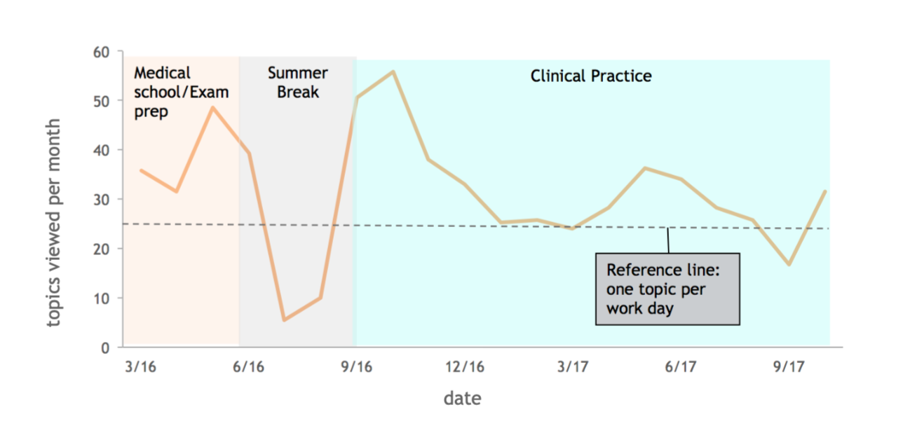
UpToDate looked to be a useful tool for students
Usage data from the University of Rwanda showed us that medical students were using UpToDate to prepare for exams and subsequently incorporating UpToDate into their clinical practice.
Source: Valtis et al., unpublished data. n = 70 graduating Rwandan students.
Notes:
African students own electronic devices and change study behaviors when given UTD access
Increased fund of knowledge: exam performance in internal medicine & pediatrics improved with UTD usage

Slide 5
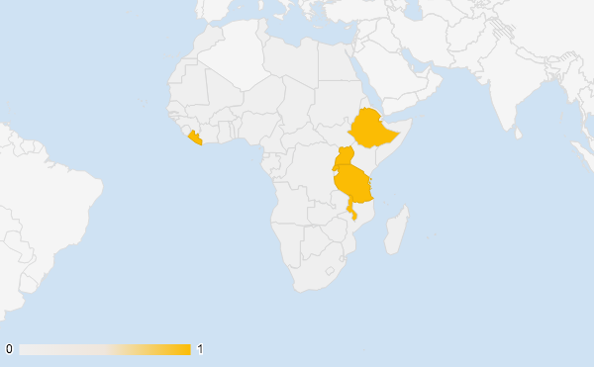
Better Evidence for Training
Encouraged by the results of the study at the University of Rwanda and Muhimbili University of Health and Allied Science, the Better Evidence for Training Program launched in 2019 at:
  University of Liberia
  Addis Ababa University
  Mbarara University
  Makerere University
  University of Rwanda
  University of Global Health Equity
  Muhimbili University of Health and Allied Science
  University of Malawi
Cohort 1
Addis Ababa University
Mbarara University
University of Liberia
Makerere University
University of Rwanda
University of Global Health Equity
Muhimbili University of Health and Allied Science
University of Malawi
Notes:
The program is doubling in 2020

Slide 6
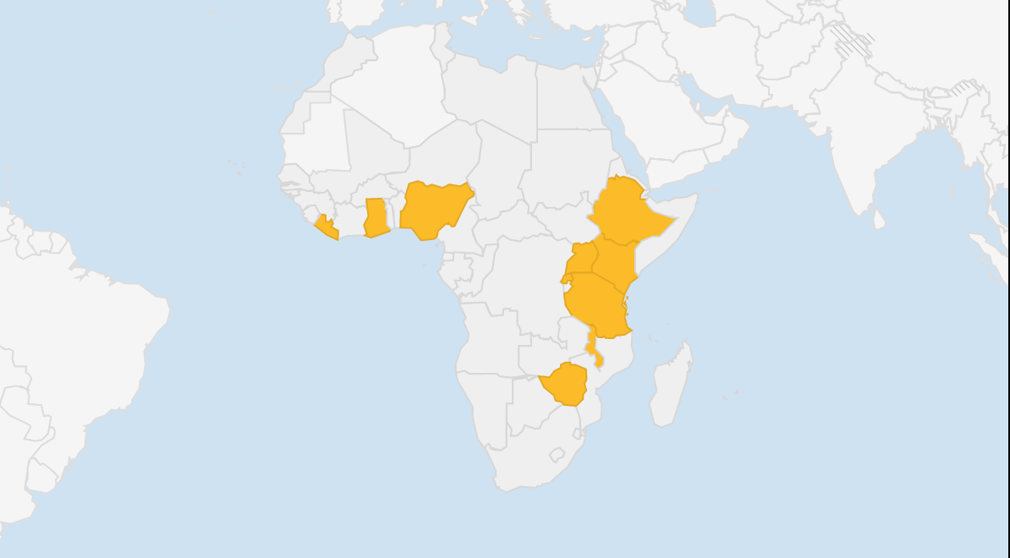
Better Evidence for Training
Cohorts 1 and 2
Addis Ababa University
Mbarara University
Kabale University
Makerere University
Moi University
University of Liberia
Kabarak University
University of Ghana
University of Ibadan
University of Rwanda
Lagos State University
University of Global Health Equity
Muhimbili University of Health and Allied Science
University of Dar es Salaam
University of Zimbabwe
University of Malawi

Slide 7


The Better Evidence Program
Mission
To enhance access and uptake of the latest clinical evidence among current and future health care providers serving vulnerable populations.
Vision
All providers will routinely access the best available evidence for diagnosis and treatment to provide the best possible care everywhere.

Slide 8
Better Evidence Collaboration Model
Donate subscriptions
UpToDate
Better Evidence
Medical Schools
Build and maintain updated digital tool/app
Identify eligible schools
Manage and promote the program on site
Support schools in gaining access
Communicate to stakeholders
Facilitate use of the tool
Aid in onboarding and training students and faculty
Support graduating trainees in enrolling in the Better Evidence for Provider program to ensure continued access
Provide feedback to Better Evidence for program improvement
Notes:
The Better Evidence for Training team does not work for UpToDate - we are an independent team. However, we work closely between the medical school and the UpToDate team. Please reach out to us with any questions, comments, or feedback and we are more than happy to relay your input to the UpToDate team.

Slide 9
What is UpToDate
UpToDate is a clinical decision support tool authored by 7,100 world-renowned physicians who synthesize the most recent medical information into trusted, evidence-based recommendations accessible via the web or download, on a computer or a smartphone.
Over 1.9 million clinicians in over 190 countries rely on UpToDate to find the answers to pressing questions.
Every day, clinicians view topics covering 25 specialties over 1.6 million times.

Slide 10
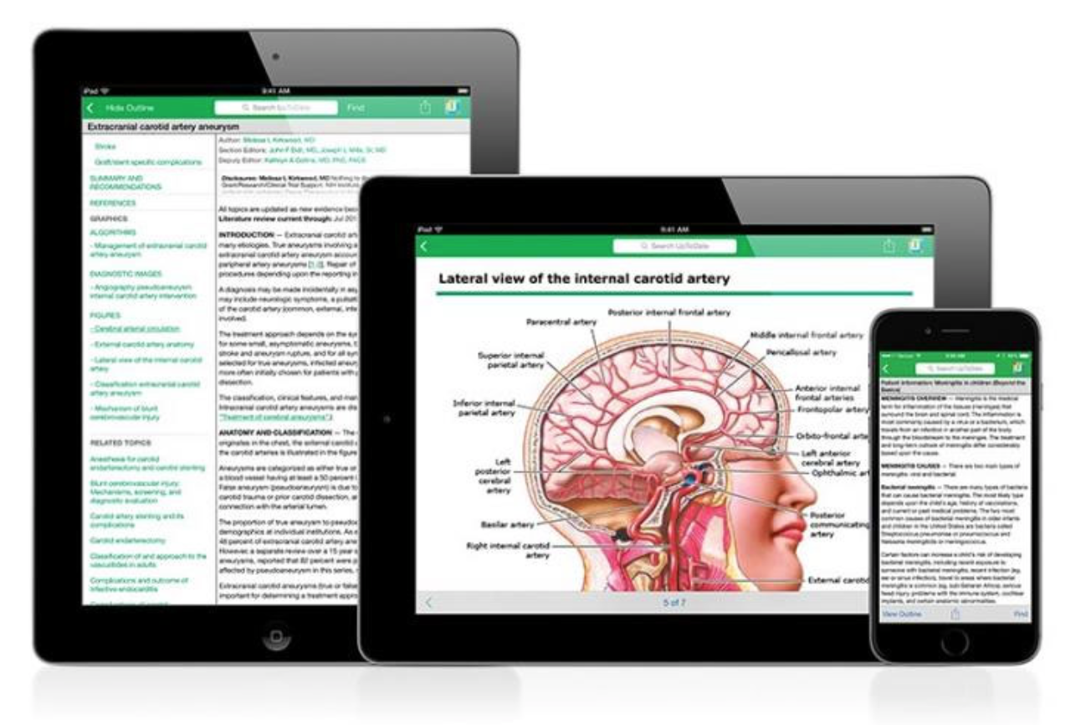
What is UpToDate?
UpToDate impacts 300,000 medical decisions globally every day
Clinicians report information provided by UpToDate changes their decision 30% of the time
Notes:
Source: https://play.vidyard.com/hkY5oQNMzbvGqyKPvuaGGa.jpg?

Slide 11
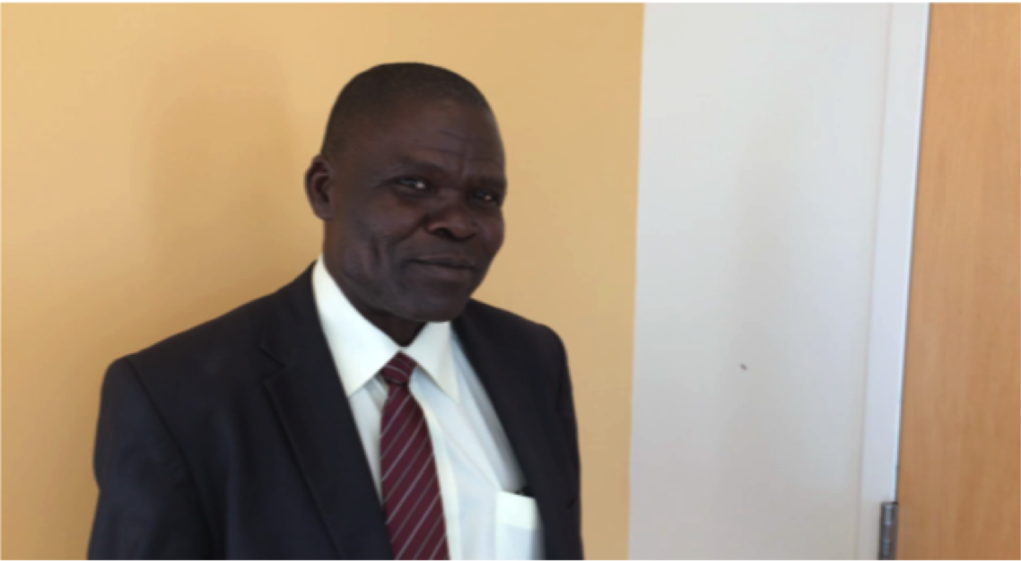
Reaching the Next Generation of Providers
“The students and faculty really struggle to access information. The easiest tool they use is Google, and Google gives you too much information, which is mixed up and not really organized. We are excited to access UpToDate because it gives you information in an easy and well-digested manner that you can easily follow. You have the etiology of the disease. You have the epidemiology, and then it describes for you how to manage the patient in a very simple way.”
- Dean Emeritus, Mbarara University of Science and Technology, Uganda

Slide 12
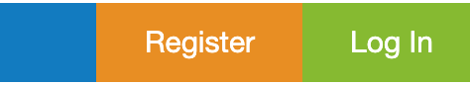
How to Register
Connect to wifi via registered/university IP address
Visit www.uptodate.com/online
Click on “register” in the top right corner
Complete the registration sheet to create a login and password, and click on “submit”
To log in next time, visit the same website and hit “login,” use the same login and password
If you forget your password, click on “forgot username and password” and follow the instructions to reset your information via email
Notes:
Some users may be able to register for an account via a data connection on site at your institution, but for most users, they must be connected to the institution's wifi network.

Slide 13
How to use UpToDate - Online at Campus
Visit www.uptodate.com/online on any computer, tablet, or phone connected your institution’s internet and log in
To keep your account active, log in from your institution’s network or the network of an associated clinical facility once every 90 days
If your account gets deactivated because you did not log in within 90 days, reactivate it by logging in from your institution’s network
Notes:
UpToDate is set up to ensure users are in fact associated with each facility, and to ensure that association requires users to log on to UpToDate from the institution’s network or an associated facility every 90 days.

Slide 14
How to use UpToDate - Online off Campus
MobileComplete
Visit www.uptodate.com/online on any computer, tablet, or phone connected to the internet or data and log in
Download the mobile app to use UpToDate MobileComplete on your mobile phone or tablet
To keep your account active, log in from your institution’s network once every 90 days
If your account gets deactivated because you did not log in within 90 days, reactivate it by logging in from your institution’s network

Slide 15
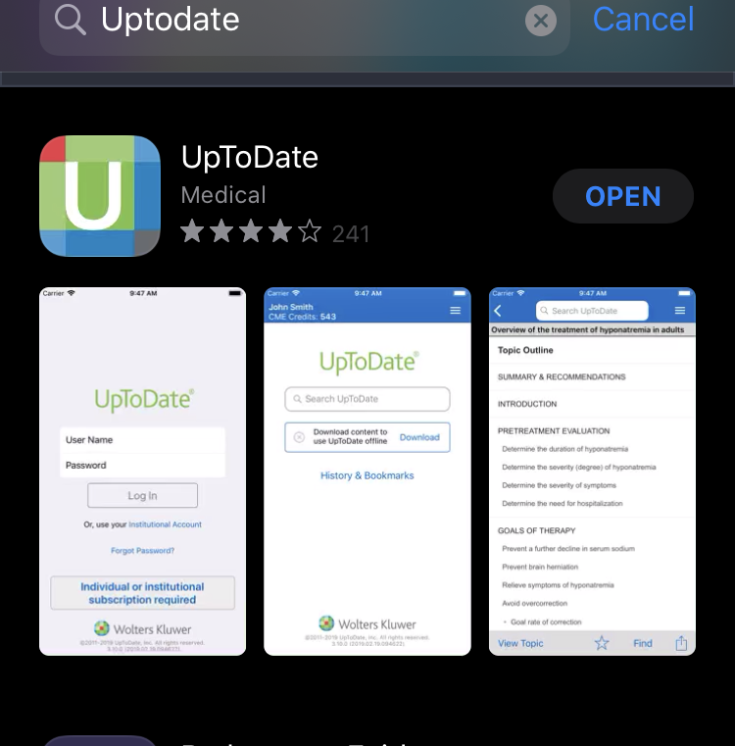

How to Download the Mobile App
In the Google Play, Amazon for Android Android or Apple App store, search “UpToDate”
Download the UpToDate App
All subscriptions come with the option to download UpToDate content for use offline through the app, called MobileComplete
Notes:
A minimum of 1.3 GB of local storage is required for both topics and graphics; 400MB of local storage is required for topics only

Slide 16
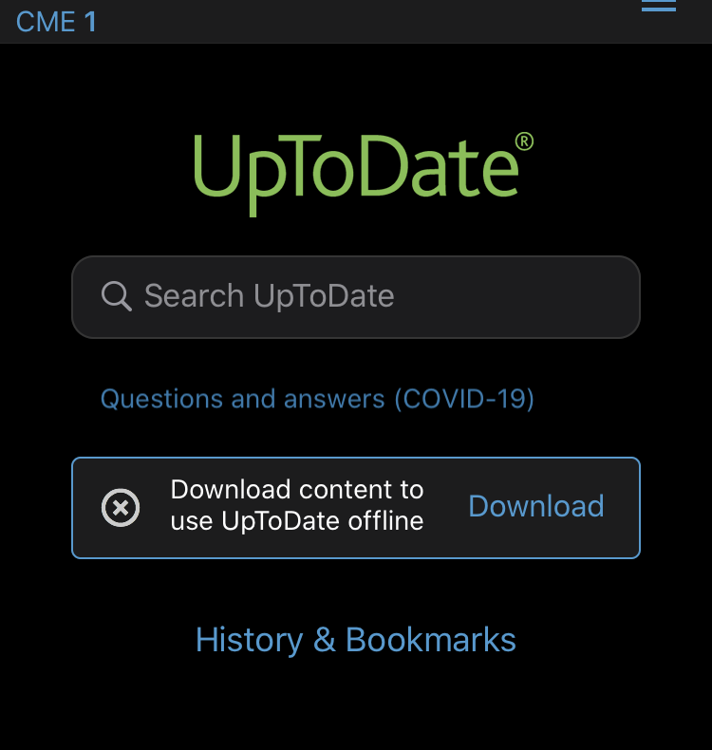
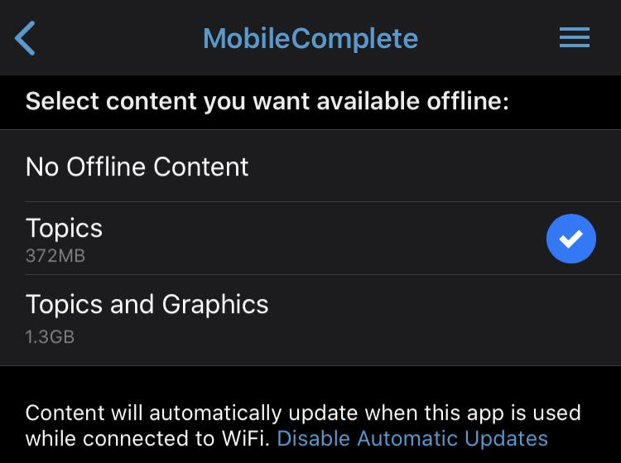
How to use UpToDate - Offline
Log into the UpToDate Mobile app
Select “Download content to use UpToDate offline”
Choose the content you want available offline via MobileComplete

Slide 17
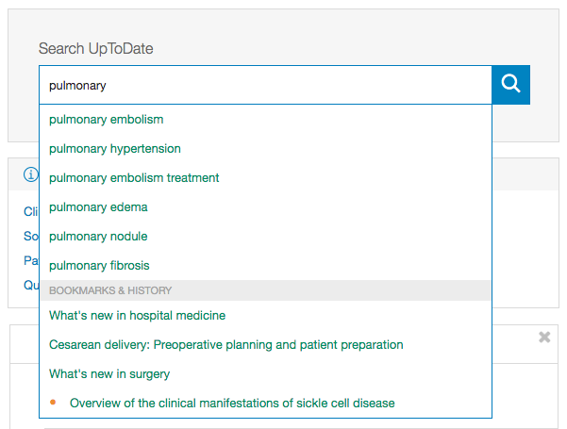
How to Conduct a Search
In the search bar, search by disease, symptom, lab abnormality, procedure, or drug
UpToDate will suggest search terms
Click the search button to go to the search results page
UpToDate also allows for searches in Spanish, French, English, Chinese, Japanese, German, Portuguese, and Italian

Slide 18
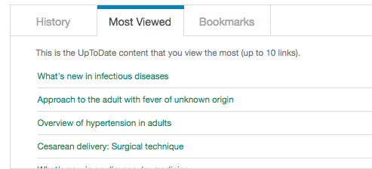

Search Page Additional Functions
What’s new? – provides important topic updates by specialty
Bookmarks – includes pages that you bookmarked
Calculators – links to many calculators that you can use in your clinical practice
Practice changing updates – provides updates for the most recent guidelines, by specialty

Slide 19
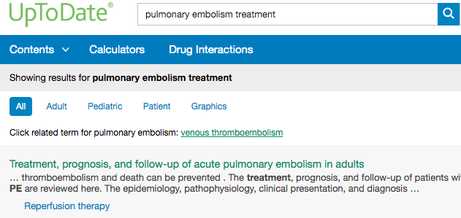
UpToDate Search Results Page
Topics are displayed by relevance criteria
To filter a search, select select All, Adult, Pediatric, Patient, or Graphics at the top of the screen under the search bar
  Adult: clinical content relevant to adult patients
  Pediatrics: clinical content relevant to pediatric patients
  Patient: patient-focused resources (i.e. patient education)
  Graphics: over 30,000 graphics available, can be exported directly to PowerPoint
Notes:
UpToDate contains over 30,000 graphics which can be directly exported to PowerPoint

Slide 20
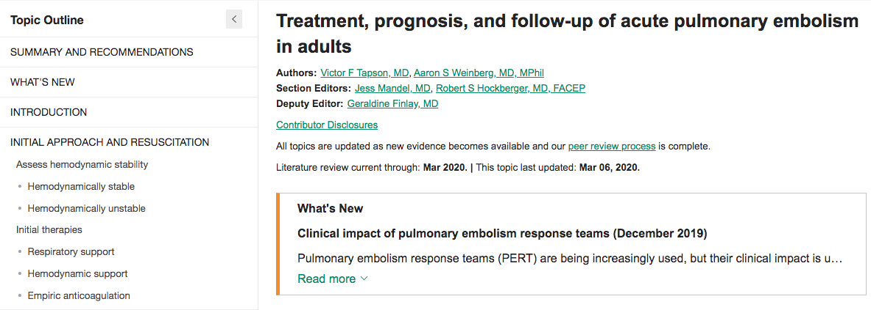
Topic Navigation and Functionality

Slide 21
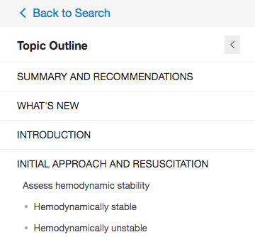
Topic Navigation and Functionality
Topic Outline – provides a table of contents for the topic; at the bottom, find links to related topics if this search did not yield what you were looking for
Search Bar – use to search within the topic for specifics (i.e. ‘complications’ or the name of a medication)
Bookmark – hit “bookmark” on the top right corner to save the current page
Drug Referencing – clicking on the drug name within the search result brings up that drugs Lexicomp page, which describes dosing, contraindications, drug interactions, etc.
References – clicking on an in-text citation brings up the full reference and abstract, which you can then access through HINARI to read more about the topic

