Slide 1
Better Evidence and UpToDate
Training Module 1: Registration and Download
2020

Slide 2
Contents
What is UpToDate Anywhere
Product Demo Overview
Benefits of Registration
How to register for UpToDate
How to install MobileComplete

Slide 3
What is UpToDate Anywhere?
Remote access from any computer with an Internet connection.
CME/CE/CPD credits when researching a clinical question using UpToDate onsite or remotely — including on your mobile device.
History, Most Viewed, Bookmarks — to quickly access the content you find most valuable.
Automatically Sync your History, Bookmarks and Most Viewed across all devices you use to access UpToDate, such as a desktop or mobile device.
What’s New Notifications alert you when topics you’ve previously viewed have been updated to include discussion of new articles from the medical literature.
The “Current UpDate” bi-weekly e-newsletter with important clinical updates from UpToDate’s editorial team.

Slide 4
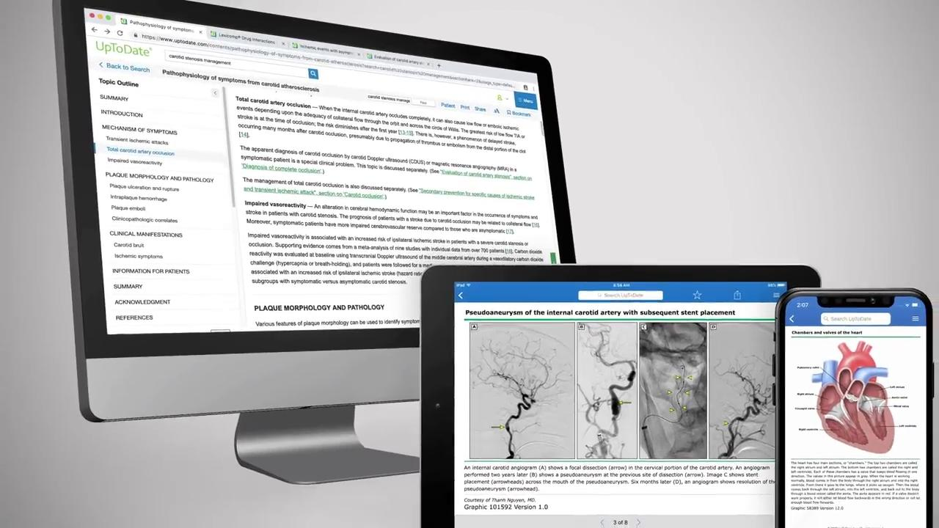
Product Demonstration Overview
Notes:
The following video will address:
Search capabilities
Patient education language
Narrowing search results to pediatric and adult evidence
Graphics and algorithms
Drug interactions
Medical calculators

Slide 5
Benefits of Registration
Notes:
The following video will address:
Access to the iOS®️ or Android™ UpTodate application (MobileComplete)
Remote Access
Clinical Newsletter
Continuing Medical Education/Continuing Professional Development credits

Slide 6
How to Register
Visit www.uptodate.com/online
Click on “register” in the top right corner
Complete the registration sheet to create a login and password, and click on “submit”
To log in next time, visit the same website and hit “login,” use the same login and password
If you forget your password, click on “forgot username and password” and follow the instructions to reset your information via email

Slide 7
UpToDate Mobile Complete
Enables UpToDate Anywhere users to download the UpToDate content on up to two of iOS® or Android™ devices.
Allows access to UpToDate with limited or no Internet connection.
To Download and Install:
1. Search for “UpToDate” in your app store.
2. Open the UpToDate Mobile App and log in with your UpToDate username and password. You only need to do this once — the app remembers your user name and password.

