Slide 1
Better Evidence and UpToDate
Training Module 2: Personalizing the User Experience
2020

Slide 2
Contents
How to Conduct a Search
Personalizing the User Experience
Topic Navigation and Functionality

Slide 3
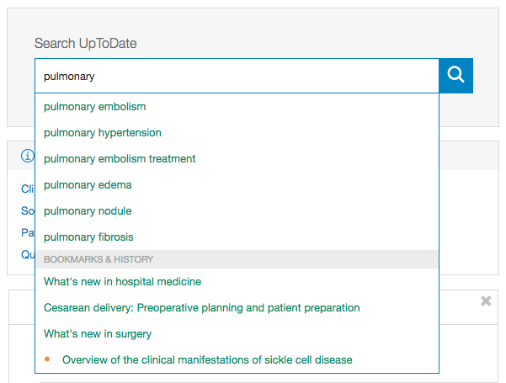
How to use the Search Box
In the search bar, search by disease, symptom, lab abnormality, procedure, or drug
UpToDate will suggest search terms
UpToDate also allows for searches in Spanish, French, English, Chinese, Japanese, German, Portuguese, and Italian
Notes:
UpToDate Conducting a Search video: https://www.uptodate.com/home/uptodate-conducting-search

Slide 4
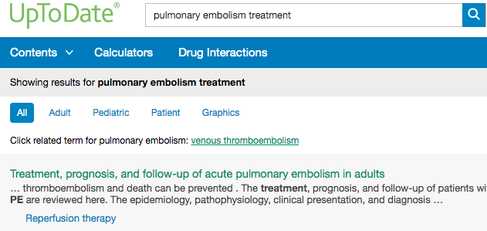
UpToDate Search Results Page
Topics are displayed by relevance criteria
To filter a search, select All, Adult, Pediatric, Patient, or Graphics at the top of the screen under the search bar
Adult: clinical content relevant to adult patients
Pediatrics: clinical content relevant to pediatric patients
Patient: patient-focused resources (i.e. patient education)
Graphics: over 30,000 graphics available, can be exported directly to PowerPoint

Slide 5
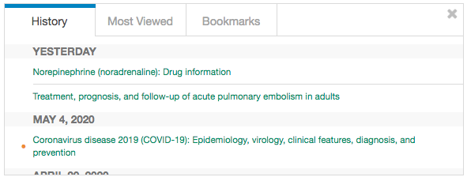
Personalizing the User Experience
View a history of content you have previously read
Keep track of updates to topics you visit most frequently - an orange dot next to a topic indicates the topic has been updated since your last viewing
Bookmark UpToDate topics you wish to revisit

Slide 6
Personalizing the User Experience

Slide 7
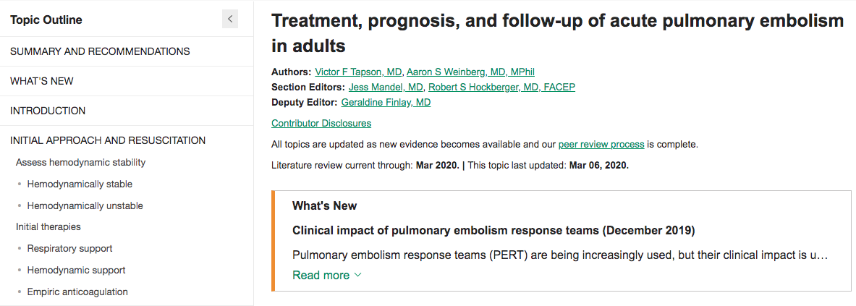
Topic Navigation and Functionality
Notes:
Replace closer to training with more recent screenshot, in case “current through” date changes

Slide 8
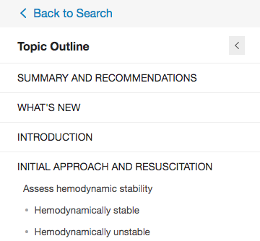
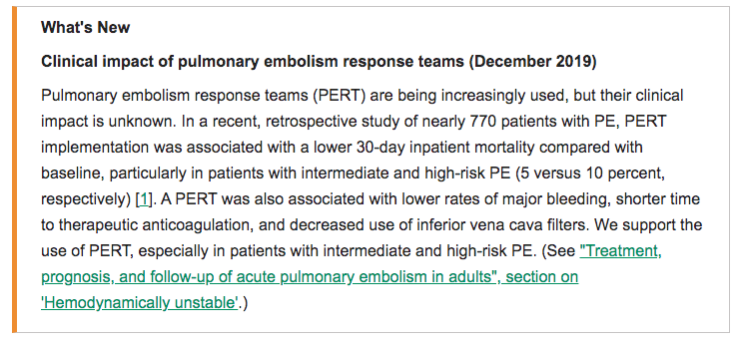
Topic Navigation and Functionality
Topic Outline – provides a table of contents for the topic; at the bottom, find links to related topics if this search did not yield what you were looking for

Slide 9
Topic Navigation and Functionality
Search Bar – use to search within the topic for specifics (i.e. ‘complications’ or the name of a medication)
Bookmark – click “bookmark” on the top right corner to save the current page

Slide 10
Topic Navigation and Functionality
References and full-text Research Articles – clicking on an in-text citation brings up the full reference and abstract, which you can then access through HINARI to read more about the topic

Slide 11
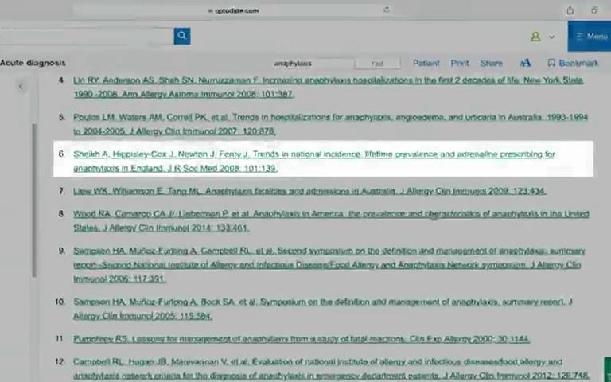
References and Full-Text Research Articles

Slide 12
Topic Navigation and Functionality
Graded Recommendations - All recommendations are associated with grades that address the strength of the recommendation and the quality of supporting evidence

Slide 13
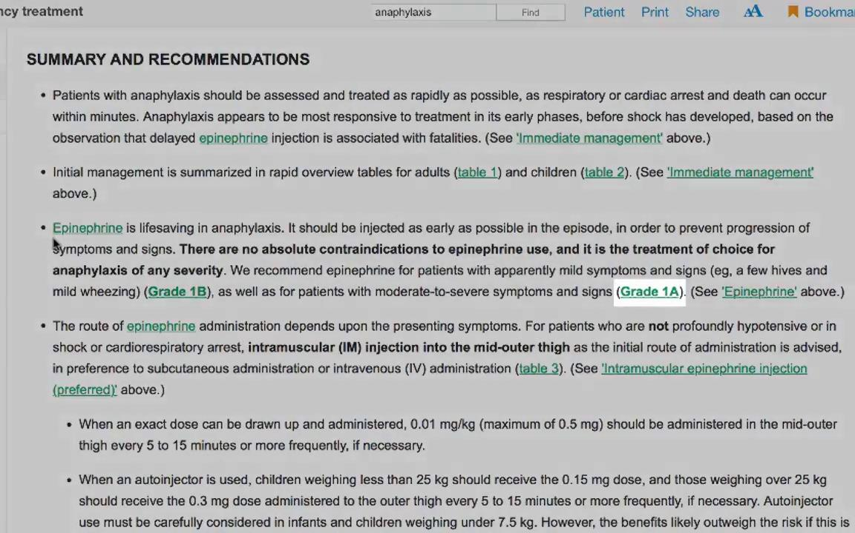
Graded Recommendations

Slide 14
Topic Navigation and Functionality
Drug Referencing – clicking on the drug name within the search result brings up that drug’s Lexicomp page, which describes dosing, contraindications, drug interactions, etc.

