Slide 1
Better Evidence and UpToDate
Training Module 3: Additional UpToDate Functionality
2020

Slide 2
Contents
Drug Database and Drug Interactions
How to use Clinical Calculators
Graphics and Algorithms

Slide 3
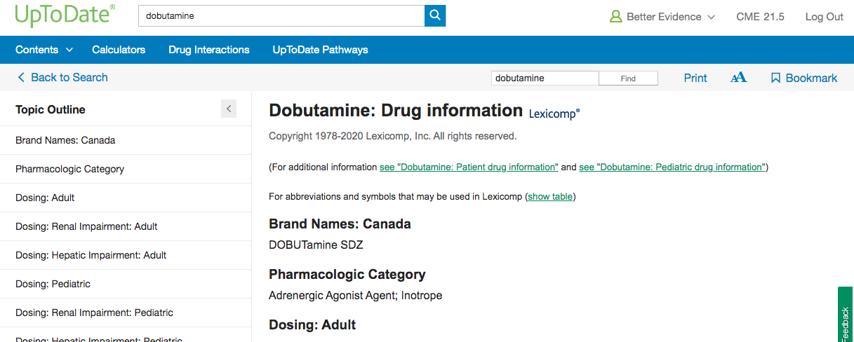
Drug Database
UpToDate contains more than 6,300 unique adult, pediatric, and international drug entries provided by Lexicomp®. The following video introduces the drug database.

Slide 4
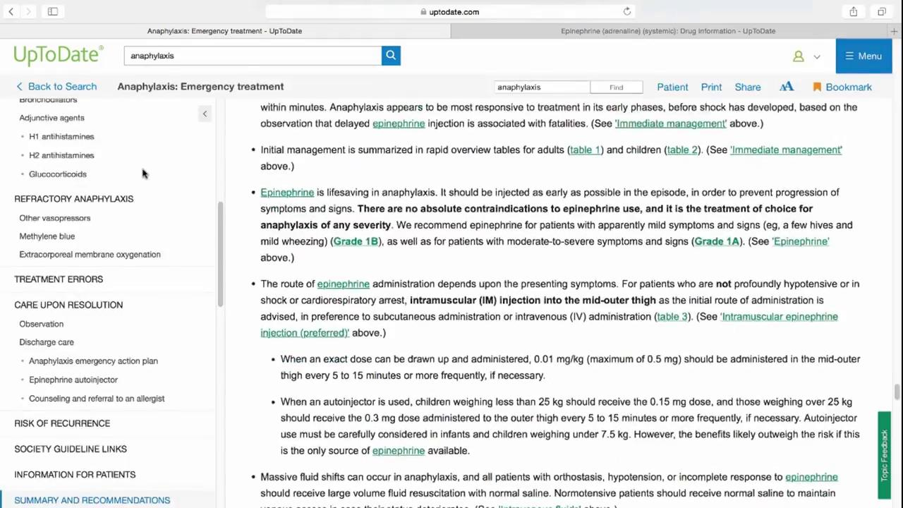
Drug Database

Slide 5
Link to a drug within an article
Drug Referencing – clicking on the drug name within the search result brings up that drug’s Lexicomp page, which describes dosing, contraindications, drug interactions, etc.

Slide 6
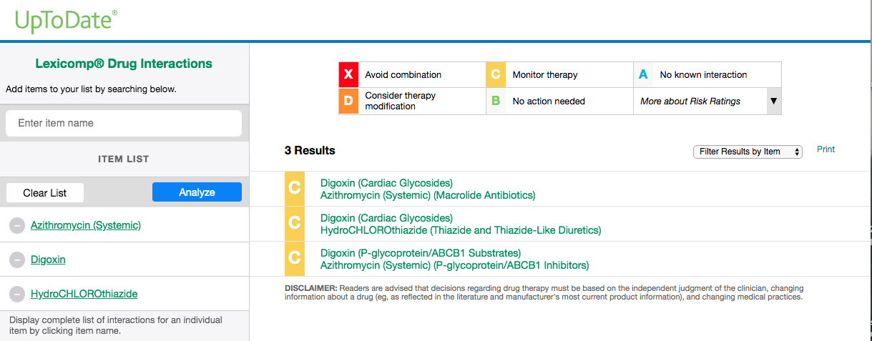
Drug Interactions
To help minimize risk and increase patient safety, UpToDate includes a drug interactions analysis tool. The following video explores the Drug Interaction tool
Notes:
Please note: the drug interactions tool allows you to search interactions that aren’t medical drugs, for example: green tea, alcohol, St. John’s Wart, etc.

Slide 7
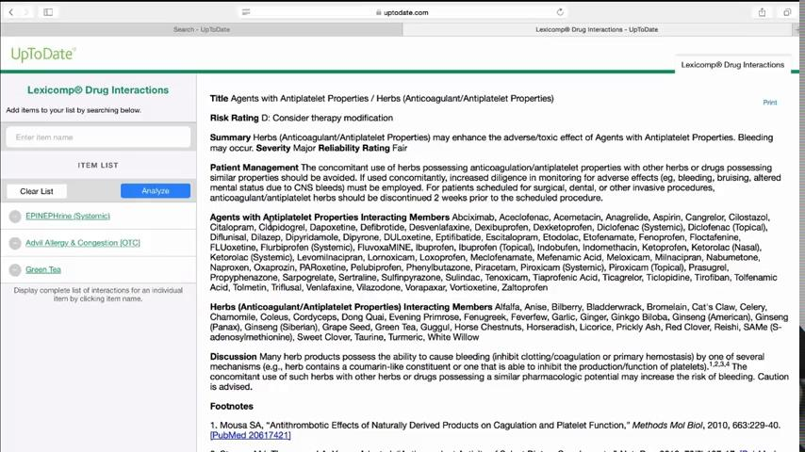
Drug Interactions
Notes:
Please note: the drug interactions tool allows you to search interactions that aren’t medical drugs, for example: green tea, alcohol, St. John’s Wart, etc.

Slide 8
Drug Interactions

Slide 9
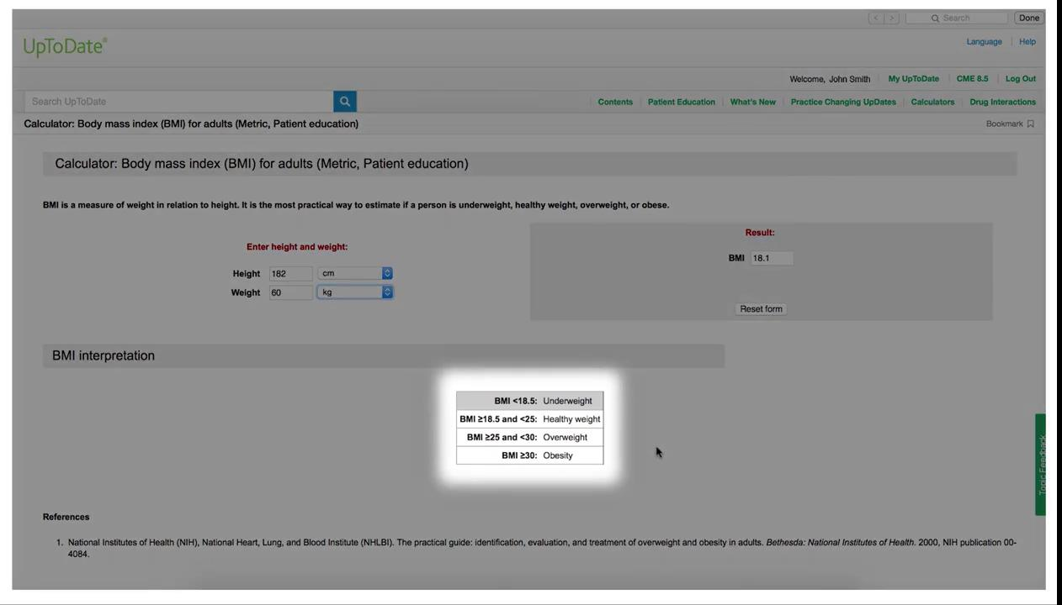
UpToDate Clinical Calculators
UpToDate provides easy access to more than 195 medical calculators right in the clinical workflow

Slide 10
UpToDate Graphics and Algorithms
UpToDate contains more than 35,000 pictures, figures, tables, graphs, algorithms, and videos.

