Slide 1
Better Evidence and UpToDate
Training Module 4: Using Your Institutional Account
2020

Slide 2
Contents
UpToDate Global Health Topics
Institutional Subscription
Continuing Medical Education (CME) Credit through UpToDate
Becoming an UpToDate Certified Trainer

Slide 3
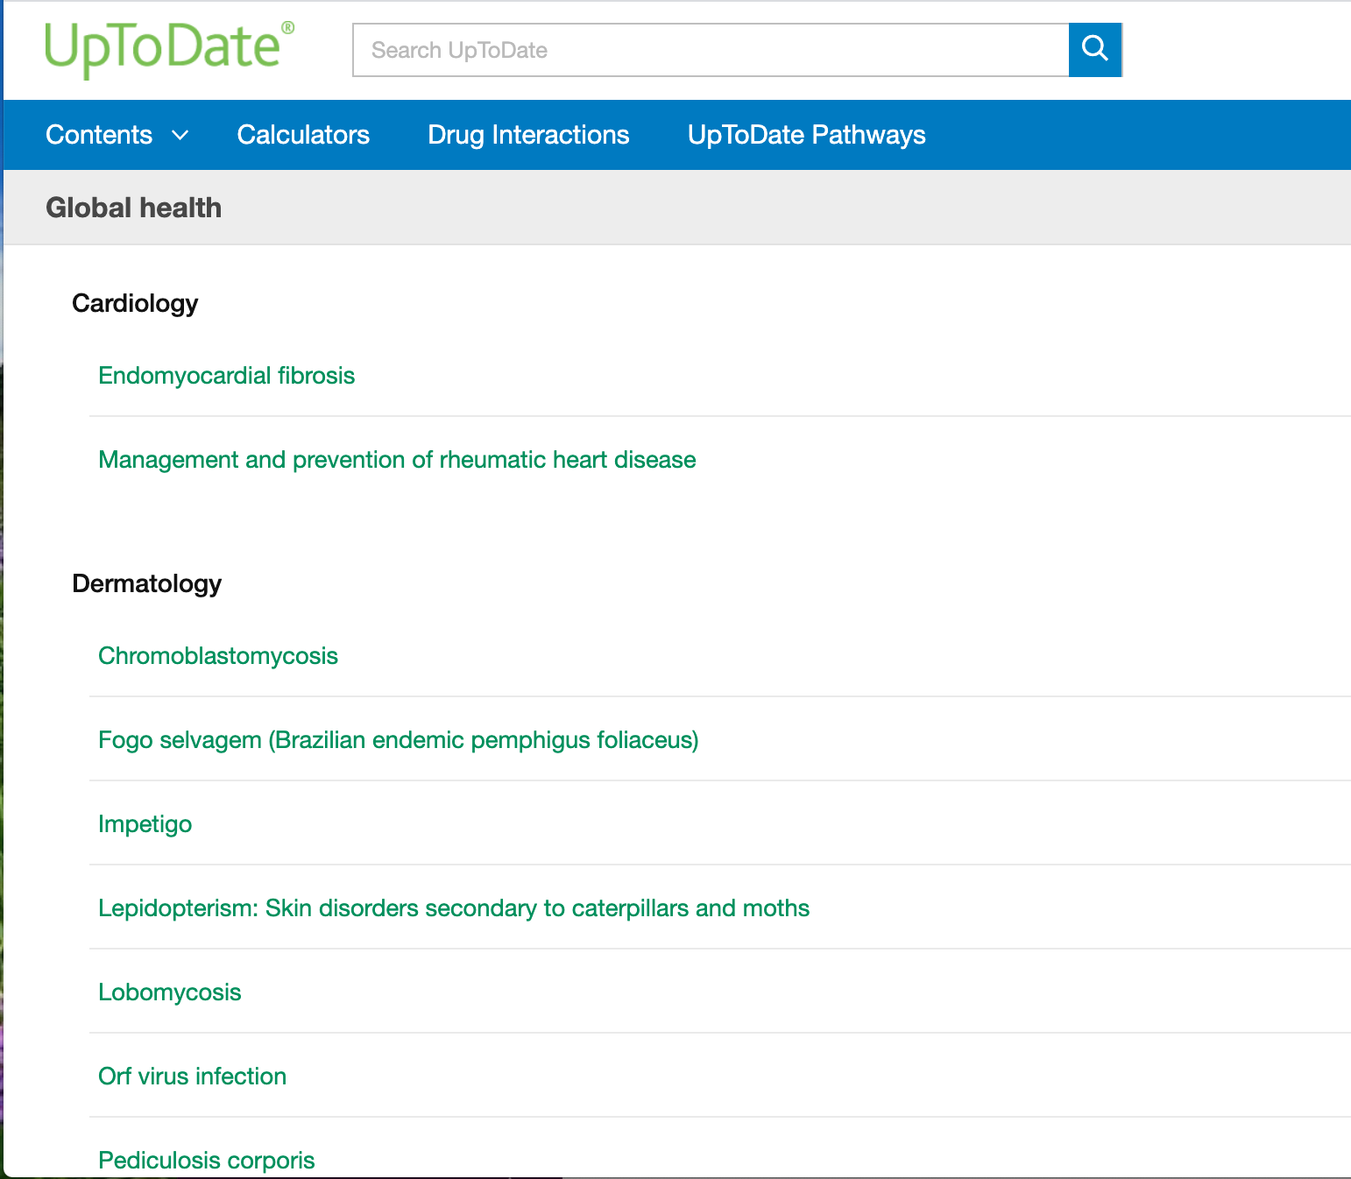
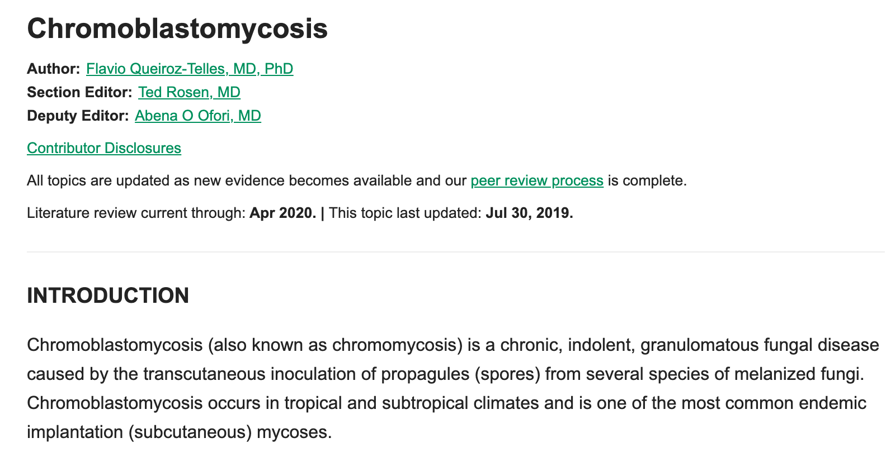
Global Health Topics
UpToDate has a selection of topics specific to global health: https://www.uptodate.com/contents/table-of-contents/infectious-diseases/global-health
Notes:
https://www.uptodate.com/home/uptodate-resource-limited-settings
https://www.uptodate.com/contents/table-of-contents/infectious-diseases/global-health
UpToDate provides a specific section of topics created or modified for resource-limited settings.

Slide 4
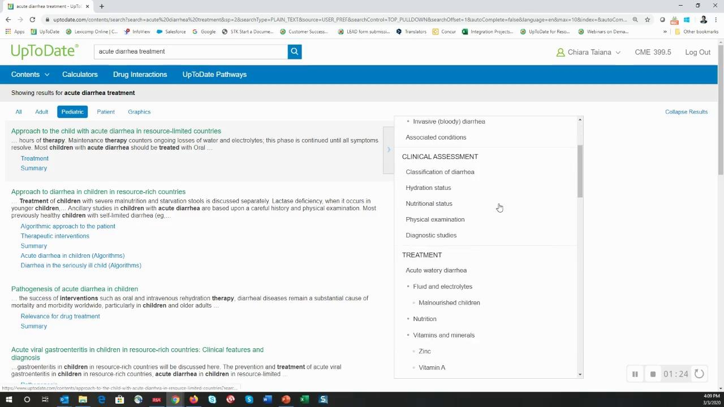
Global Health Topics
Notes:
https://www.uptodate.com/home/uptodate-resource-limited-settings

Slide 5
Institutional Subscription
To set up an individual account, register for UpToDate from your home institution or from an affiliated facility with UpToDate coverage
To keep your account active, you must log in from your institution’s network or an associated clinical facility once every 90 days (temporarily changed to 180 days for the duration of the COVID-19 pandemic)
If you do not log in at least once every 90 days, your account will be deactivated
To reactivate a deactivated account, you must log in from your institution’s network or an associated clinical facility

Slide 6
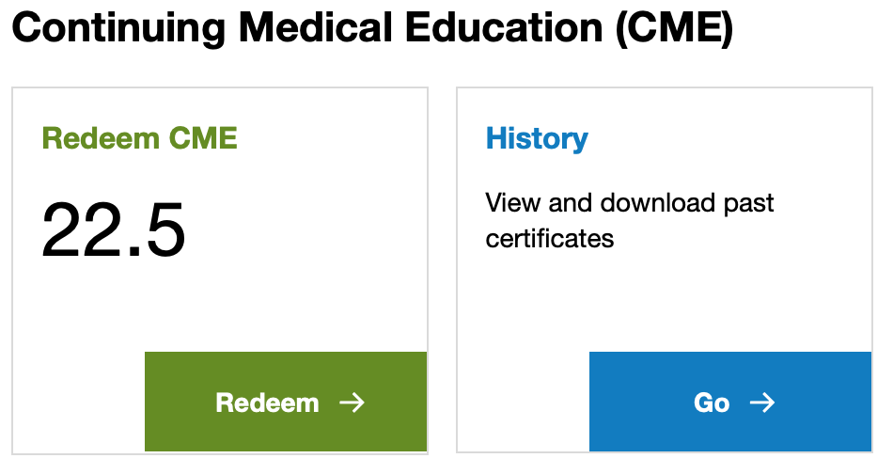
Continuing Medical Education Credit
UpToDate is accredited and recognized as a continuing education resource by colleges, associations, and authorities from around the world
UpToDate users in over 160 countries have redeemed CME credits through UpToDate use
UpToDate offers formal accreditation in 21 countries
UpToDate CME is accepted by 50+ accrediting bodies worldwide
Notes:
CME can be transferred from an individual to an institutional account - if this is the case, please reach out to us at betraining@ariadnelabs.org and we will initiate the account transfer.

Slide 7
UpToDate Certified Trainer Program
If you are interested in deepening your knowledge of UpToDate and helping spread use of the tool at your institution, consider pursuing the UpToDate Certified Trainer Program
As an UpToDate Certified Trainer you will:
Become an expert on using UpToDate to support colleagues within your institution
Gain valuable insights before everyone else into all the features and benefits of using a clinical decision tool, like UpToDate
Receive a framed certificate and customized poster to show your personal achievement and value to your institution

Slide 8
UpToDate Certified Trainer Program
Below is an outline of the steps you will take through the certification process:
Fill out the registration form
Complete Modules 1-5
Pass Certification Test
Each module is approximately 15 minutes long. The entire process shouldn't take more than two hours of your time. Once you pass the certification test, you will become a member of a community of UpToDate advocates across the globe with access to:
The UpToDate Certified Trainer Portal and Forum
Customizable posters/tip sheets/templates and other materials
Regional Certified Trainer and Clinical Advocate events

